Slide 1
References
Stefan Buttcher, Charles L. A. Clarke and Gordon V. Cormack (2010). Information Retrieval: Implementing and Evaluating Search Engines. MIT Press.
Christopher D. Manning, Prabhakar Raghavan and Hinrich Schütze (2008). Introduction to Information Retrieval. Cambridge University Press.

Slide 2
Information Retrieval System
Information retrieval (IR) is finding material (usually documents) of an unstructured nature (usually text) that satisfies an information need from within large collections (usually stored on computers).

Slide 3
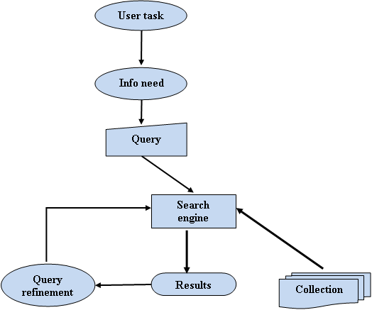
(Fig. 1) The general structure of information retrieval (Classic search model).

Slide 4
The four main steps of IR are
• Preprocessing
• Term representation
• Dimensionality reduction
• IR algorithm.

Slide 5
The various sub-tasks performed in the preprocessing stage are tokenization, tagging, and removing stop words. Dimensionality reduction aims to reduce the number of words by extracting or selecting the useful words under consideration. Within or after the dimensionality reduction step, term representation is applied to list and index words in the document. Finally, an IR algorithm is invoked to find the best answer for the user query.

Slide 6
Preprocessing Stage
The preprocessing stage is a preparatory stage that aims to prepare and provide documents for IR. The preprocessing module performs many steps such as tokenization and stops word removal and Normalization. In addition, a stemming step can optionally be performed.

Slide 7
tokenization
The first step in processing is tokenization, which divides an input text into lexical term units (i.e., words) that are separated by spaces and are then represented as a bag-of-words w= (w₁, . . . , w_{m}). For example, the tokenization of the sentence “Information retrieval is finding material of an unstructured nature that satisfies an information need from within large collections” is {“Information”, “retrieval”, “is”, “finding”, “material”, “of”, “an”, “unstructured”, “nature”, “that”, “satisfies”, “an”, “information”, “need”, “from”, “within”, “large”, “collections”}.

Slide 8
stops word removal.
Then, frequent words that do not contain significant information are eliminated such as stop words (sometimes known as a stop list). Removing such words improves IR system performance by ignoring words that frequently appear in every document. Therefore, stop words are not important features for retrieval. In addition, the number of indexing words will be reduced, saving space and time. Such words include auxiliary verbs (e.g., is, are, will, was and prepositions (e.g., to, at).

